Slide 1
Introduction to Software Engineering
Matakuliah Rekayasa Perangkat Lunak (CS215) – Gasal 2015/2016
Magister Ilmu Komputer - Universitas Budi Luhur
Achmad Solichin, S.Kom, M.T.I (achmatim@gmail.com)

Slide 2
Overview
What is Software?
Software Application Types
Software Engineering Definition
FAQ about Software Engineering
Software Myths

Slide 3
What is Software?
Software is: (1) instructions (computer programs) that when executed provide desired features, function, and performance; (2) data structures that enable the programs to adequately manipulate information and (3) documentation that describes the operation and use of the programs.
[Pressman, 2010]

Slide 4
What is Software?
Software is developed or engineered, it is not manufactured in the classical sense.
Software doesn't wear out, but deterioration.
Although the industry is moving toward component-based construction, most software continues to be custom-built.
[Pressman, 2010]

Slide 5
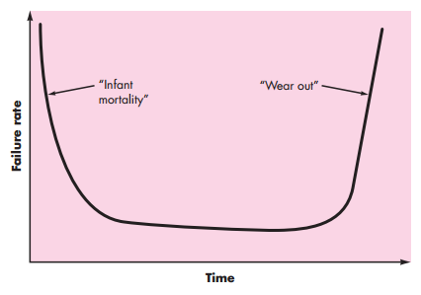
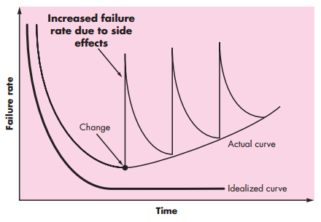
Wear-out vs. Deterioration
Hardware
Software
[Pressman, 2010]

Slide 6
7 Software Applications
System software: such as compilers, editors, file management utilities
Application software: stand-alone programs for specific needs.
Engineering/scientific software: Characterized by “number crunching” algorithms, such as automotive stress analysis, molecular biology, orbital dynamics etc
Embedded software: resides within a product or system, such as key pad control of a microwave oven, digital function of dashboard display in a car
[Pressman, 2010]

Slide 7
7 Software Applications
Product-line software: focus on a limited marketplace to address mass consumer market. Ex. word processing, graphics, database management
WebApps (Web applications): network centric software. As web 2.0 emerges, more sophisticated computing environments is supported integrated with remote database and business applications.
AI software uses non-numerical algorithm to solve complex problem. Robotics, expert system, pattern recognition game playing
[Pressman, 2010]

Slide 8
Software Applications – New
Open world computing—pervasive, distributed computing
Ubiquitous computing—wireless networks
Netsourcing—the Web as a computing engine
Open source—”free” source code open to the computing community (a blessing, but also a potential curse!)
And also …
Data mining
Grid computing
Cognitive machines
Software for nanotechnologies
[Pressman, 2010]

Slide 9
Application Type
Stand-alone applications
Interactive transaction-based applications
Embedded control systems
Batch processing systems
Entertainment systems
Systems for modeling and simulation
Data collection systems
Systems of systems
[Sommerville, 2011]

Slide 10
Legacy Software
Why must it change?
software must be adapted to meet the needs of new computing environments or technology.
software must be enhanced to implement new business requirements.
software must be extended to make it interoperable with other more modern systems or databases.
software must be re-architected to make it viable within a network environment.
[Pressman, 2010]

Slide 11
Web Applications
Network intensiveness. A WebApp resides on a network and must serve the needs of a diverse community of clients.
Concurrency. A large number of users may access the WebApp at one time.
Unpredictable load. The number of users of the WebApp may vary by orders of magnitude from day to day.
Performance. If a WebApp user must wait too long (for access, for server-side processing, for client-side formatting and display), he or she may decide to go elsewhere.
Availability. Although expectation of 100 percent availability is unreasonable, users of popular WebApps often demand access on a “24/7/365” basis.
[Pressman, 2010]

Slide 12
Web Applications
Data driven. The primary function of many WebApps is to use hypermedia to present text, graphics, audio, and video content to the end-user.
Content sensitive. The quality and aesthetic nature of content remains an important determinant of the quality of a WebApp.
Continuous evolution. Unlike conventional application software that evolves over a series of planned, chronologically-spaced releases, Web applications evolve continuously.
Immediacy. Although immediacy—the compelling need to get software to market quickly—is a characteristic of many application domains, WebApps often exhibit a time to market that can be a matter of a few days or weeks.
Security. Because WebApps are available via network access, it is difficult, if not impossible, to limit the population of end-users who may access the application.
Aesthetics. An undeniable part of the appeal of a WebApp is its look and feel.
[Pressman, 2010]

Slide 13
Software Engineering
Fritz Bauer Definition
IEEE Definition
[Software engineering is] the establishment and use of sound engineering principles in order to obtain economically software that is reliable and works efficiently on real machines.
Software Engineering: (1) The application of a systematic, disciplined, quantifiable approach to the development, operation, and maintenance of software; that is, the application of engineering to software. (2) The study of approaches as in (1).
[Pressman, 2010]

Slide 14
FAQ about Software Engineering
Question | Answer
What is software? | Computer programs and associated documentation. Software products may be developed for a particular customer or may be developed for a general market.
What are the attributes of good software? | Good software should deliver the required functionality and performance to the user and should be maintainable, dependable and usable.
What is software engineering? | Software engineering is an engineering discipline that is concerned with all aspects of software production.
[Sommerville, 2011]

Slide 15
FAQ about Software Engineering
Question | Answer
What are the fundamental software engineering activities? | Software specification, software development, software validation and software evolution.
What is the difference between software engineering and computer science? | Computer science focuses on theory and fundamentals; software engineering is concerned with the practicalities of developing and delivering useful software.
What is the difference between software engineering and system engineering? | System engineering is concerned with all aspects of computer-based systems development including hardware, software and process engineering. Software engineering is part of this more general process.
[Sommerville, 2011]

Slide 16
FAQ about Software Engineering
Question | Answer
What are the key challenges facing software engineering? | Coping with increasing diversity, demands for reduced delivery times and developing trustworthy software.
What are the costs of software engineering? | Roughly 60% of software costs are development costs, 40% are testing costs. For custom software, evolution costs often exceed development costs.
What are the best software engineering techniques and methods? | While all software projects have to be professionally managed and developed, different techniques are appropriate for different types of system. For example, games should always be developed using a series of prototypes whereas safety critical control systems require a complete and analyzable specification to be developed. You can’t, therefore, say that one method is better than another.
What differences has the web made to software engineering? | The web has led to the availability of software services and the possibility of developing highly distributed service-based systems. Web-based systems development has led to important advances in programming languages and software reuse.
[Sommerville, 2011]

Slide 17
Essensial Atributes of Good Software
Product characteristic | Description
Maintainability | Software should be written in such a way so that it can evolve to meet the changing needs of customers. This is a critical attribute because software change is an inevitable requirement of a changing business environment.
Dependability and security | Software dependability includes a range of characteristics including reliability, security and safety. Dependable software should not cause physical or economic damage in the event of system failure. Malicious users should not be able to access or damage the system.
Efficiency | Software should not make wasteful use of system resources such as memory and processor cycles. Efficiency therefore includes responsiveness, processing time, memory utilisation, etc.
Acceptability | Software must be acceptable to the type of users for which it is designed. This means that it must be understandable, usable and compatible with other systems that they use.
[Sommerville, 2011]

Slide 18
Software Myths (Management)
Myth
Reality
We already have a book that’s full of standards and procedures for building software. Won’t that provide my people with everything they need to know?
The book of standards may very well exist, but is it used? Are software practitioners aware of its existence? Does it reflect modern software engineering practice? Is it complete? Is it adaptable? Is it streamlined to improve time-to-delivery while still maintaining a focus on quality? In many cases, the answer to all of these questions is “no.”
[Pressman, 2010]

Slide 19
Software Myths (Management)
Myth
Reality
If we get behind schedule, we can add more programmers and catch up (sometimes called the “Mongolian horde” concept).
Software development is not a mechanistic process like manufacturing. In the words of Brooks: “adding people to a late software project makes it later.” At first, this statement may seem counterintuitive. However, as new people are added, people who were working must spend time educating the newcomers, thereby reducing the amount of time spent on productive development effort. People can be added but only in a planned and well coordinated manner.
[Pressman, 2010]

Slide 20
Software Myths (Management)
Myth
Reality
If I decide to outsource the software project to a third party, I can just relax and let that firm build it.
If an organization does not understand how to manage and control software projects internally, it will invariably struggle when it outsources software projects.
[Pressman, 2010]

Slide 21
Software Myths (Customer)
Myth
Reality
A general statement of objectives is sufficient to begin writing programs — we can fill in the details later
Although a comprehensive and stable statement of requirements is not always possible, an ambiguous “statement of objectives” is a recipe for disaster. Unambiguous requirements (usually derived iteratively) are developed only through effective and continuous communication between customer and developer
[Pressman, 2010]

Slide 22
Software Myths (Customer)
Myth
Reality
Software requirements continually change, but change can be easily accommodated because software is flexible.
It is true that software requirements change, but the impact of change varies with the time at which it is introduced. When requirements changes are requested early (before design or code has been started), the cost impact is relatively small.16 However, as time passes, the cost impact grows rapidly —resources have been committed, a design framework has been established, and change can cause upheaval that requires additional resources and major design modification.
[Pressman, 2010]

Slide 23
Software Myths (Practitioners)
Myth
Reality
Once we write the program and get it to work, our job is done.
Someone once said that “the sooner you begin ‘writing code,’ the longer it’ll take you to get done.”Industry data indicate that between 60 and 80 percent of all effort expended on software will be expended after it is delivered to the customer for the first time.
[Pressman, 2010]

Slide 24
Software Myths (Practitioners)
Myth
Reality
Until I get the program “running” I have no way of assessing its quality.
One of the most effective software quality assurance mechanisms can be applied from the inception of a project—the technical review. Software reviews are a “quality filter” that have been found to be more effective than testing for finding certain classes of software defects.
[Pressman, 2010]

Slide 25
Software Myths (Practitioners)
Myth
Reality
The only deliverable work product for a successful project is the working program.
A working program is only one part of a software configuration that includes many elements. A variety of work products (e.g., models, documents, plans) provide a foundation for successful engineering and, more important, guidance for software support
[Pressman, 2010]

Slide 26
Software Myths (Practitioners)
Myth
Reality
Software engineering will make us create voluminous and unnecessary documentation and will invariably slow us down.
Software engineering is not about creating documents. It is about creating a quality product. Better quality leads to reduced rework. And reduced rework results in faster delivery times.
[Pressman, 2010]

Slide 27
Software Engineering Ethics
Software engineering involves wider responsibilities than simply the application of technical skills.
Software engineers must behave in an honest and ethically responsible way if they are to be respected as professionals.
Ethical behaviour is more than simply upholding the law but involves following a set of principles that are morally correct.
[Sommerville, 2011]

Slide 28
Issues of Professional Responsibility
Confidentiality
Engineers should normally respect the confidentiality of their employers or clients irrespective of whether or not a formal confidentiality agreement has been signed.
Competence
Engineers should not misrepresent their level of competence. They should not knowingly accept work which is outwith their competence.
[Sommerville, 2011]

Slide 29
Issues of Professional Responsibility
Intellectual property rights
Engineers should be aware of local laws governing the use of intellectual property such as patents, copyright, etc. They should be careful to ensure that the intellectual property of employers and clients is protected.
Computer misuse
Software engineers should not use their technical skills to misuse other people’s computers. Computer misuse ranges from relatively trivial (game playing on an employer’s machine, say) to extremely serious (dissemination of viruses).
[Sommerville, 2011]

Slide 30
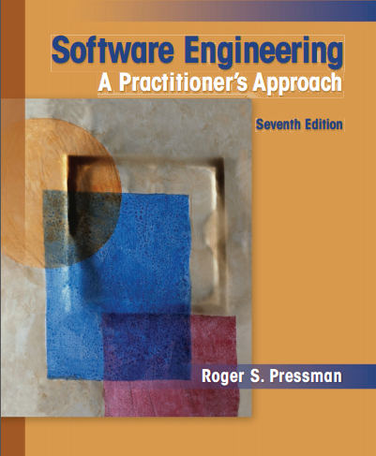
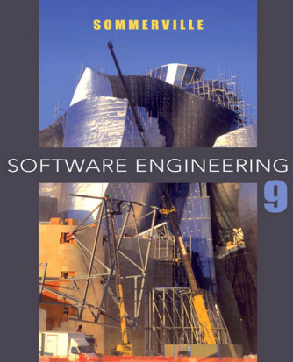
References
Roger S. Pressman, 2010, Software Engineering: A Practitioner’s Approach 7th edition, McGraw-Hill.
Ian Sommerville, 2011, Software Engineering 9th edition, Addison-Wesley.

Slide 31
Thanks
Achmad Solichin, S.Kom, M.T.I
achmatim@gmail.com
Twitter: @achmatim
Facebook: facebook.com/achmatim
Web: http://achmatim.net

